Slide 1
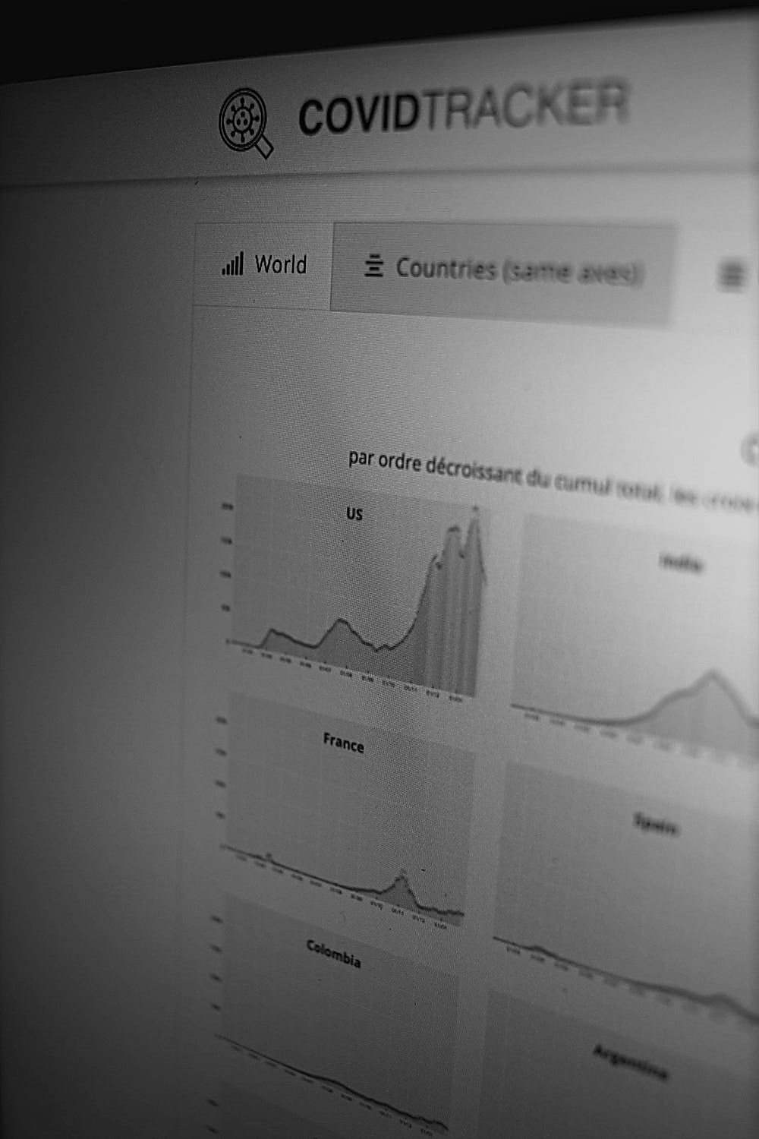

An Introduction to Time Series Analysis and Forecasting
Nadia Kennar, UKDS
Copyright © year Institution. Created by Organisation, UK Data Service.

Slide 2
Content
What is time series data?
What is time series analysis (TSA) ?
Types of TSA
Components of TSA
Fitting Time Series Models
Forecasting Techniques (ARIMA)
Available Software

Slide 3
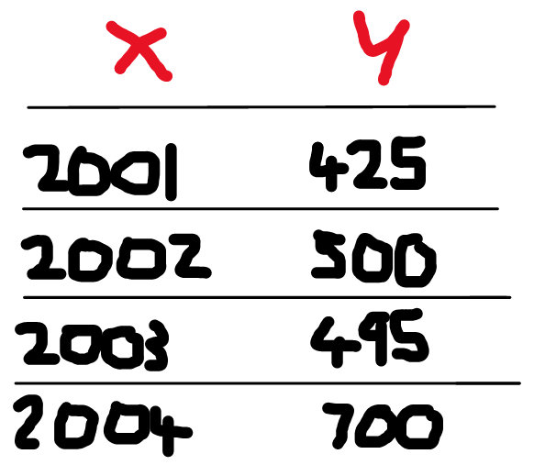
What is Time Series Data?
“ A collection of observations obtained though repeated measurements of time”
Intervals (Sampling Frequency/Periodicity)
Year
Month
Days
Quarterly
Hourly

Slide 4
Time Series Data Continued
How is time-series data different to just having a time-field in your data set?
Can longitudinal data sets be considered time-series?

Slide 5
Scenario: Web Application
Imagine you maintain a web application. You have been asked to analyse when a new user logs in
When a new user logs in, you may just update a “last_login” timestep for that user in a single row
Or, you treat each login as a separate event

Slide 6
Which option would you choose?
Option A
Option B
Notes:
Mentimeter

Slide 7
Option A
User | Company | Last_Login
A | X | 01/09/2020 13.09.00
B | Y | 01/07/2019 13.09.00
C | X | 01/09/2020 13.09.00

Slide 8
Option B
User | Company | Login
A | X | 01/09/2019 13.09.00
A | X | 02/09/2019 14:01:17
A | X | 03/09/2019 13.09.00
C | X | 04/09/2019 14.10.12
B | Y | 17/10/2021 09.00.00
B | Y | 17/11/2021 10.01.01

Slide 9
To summarise
Almost all data is recorded as a new entry
The data typically arrives in time order
Time-intervals can be regular (metrics) or irregular (events)

Slide 10
Different Aims of Time Series Analysis
Access the impact of a single event (descriptive)
To study casual patterns i.e. the effects of variables rather than events (explanatory)
To forecast future values of a time series using either previous values of one series (or values from others) (prediction)

Slide 11
Ashby 2020: Initial evidence on the relationship between the coronavirus pandemic and crime in the United States
Aim: To understand crime patterns during the pandemic. Used police-recorded open crime data to understand how the frequency of certain crime types changed from the start of the pandemic
Method: used SARIMA models of the frequency of crime types in 16 US cities between 01.01.2016 and 20.01.2020. Forecasts were created from these models to compare the actual calls to the expected
Data and Code can be found here: https://osf.io/ef4dw/

Slide 12
Reka 2022: ‘Understanding Changing Demand Police during the Coronavirus Pandemic
Method: Used a mixed-method approach of robust time series analysis and qualitative interviews with force call centre staff to explore changes in police demand during the pandemic. More specifically examining non-demand
Findings: Reduction in overall calls than would be expected in the absence of the pandemic.
Report: https://www.n8prp.org.uk/wp-content/uploads/sites/315/2022/01/Reka-Solymosi-Police-Demand-Covid.pdf

Slide 13
Case Study
Using police-recorded crime data, we want to explore Burglary rates from Detroit from 2015- 2020
Aim:
A) Explore the long-term trend and seasonality in ‘Burglary’ across the city of Detroit
B) How the frequency of Burglary changed in Detroit in 2020 (the start of the pandemic)
Notes:
So for example …

Slide 14
Steps in Time Series Analysis
Explore your data
Identify and graph patterns
Model the data
Predict

Slide 15
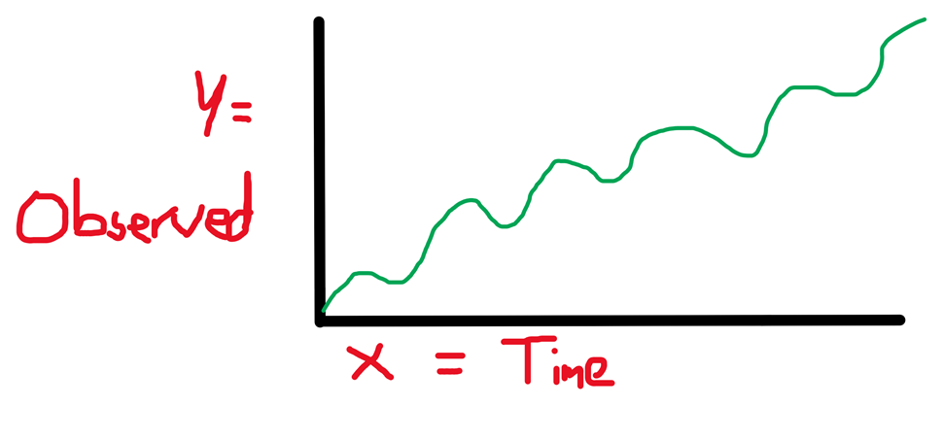
Time Series Analysis

Slide 16
What time interval would you use to study police recorded crime data?
Yearly
Monthly
Weekly
Hourly
Minutes
Any Others?!
Notes:
Mentimeter

Slide 17
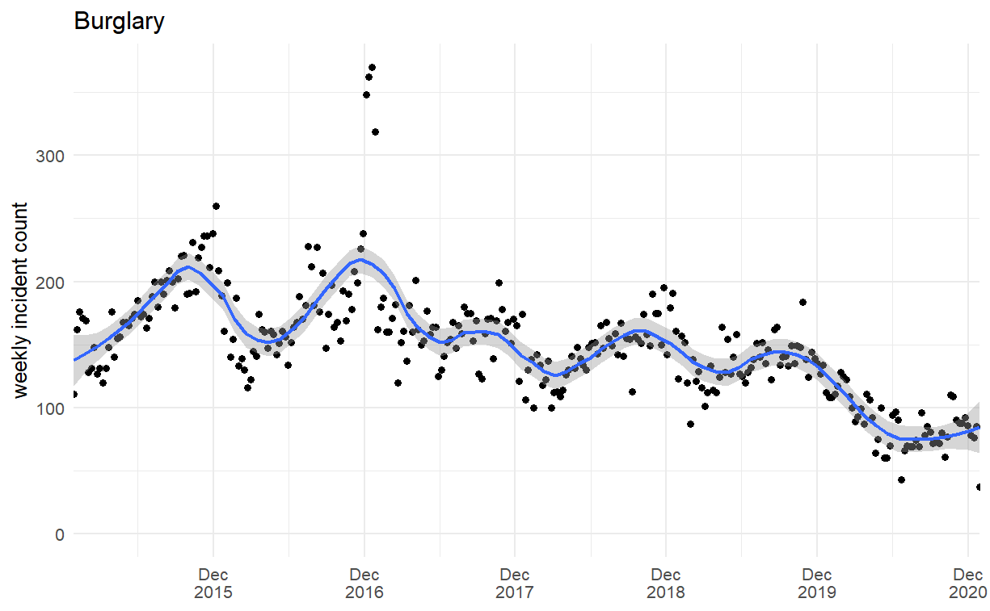
Aim A - A) Explore the long-term trend and seasonality in ‘Burglary’ across the city of Detroit

Slide 18
Components of Time Series Analysis
Trend – The linearity (increasing – decreasing)
Cyclic – repeated patterns of non-periodic fluctuations
Seasonality– Repeating patterns of behaviour over time
Random or irregular movements (noise) – Variation that cannot be explained
The combination of these components can either be
Additive
Multiplicative

Slide 19
Additive vs Multiplicative
Additive = the increasing or decreasing pattern of the time series is similar throughout the series.
Y = trend + cyclic + seasonality + noise (additive model)
Multiplicative = if the time series is having exponential growth or decrement with time
Y = trend *cyclic * seasonality * noise (multiplicative model)

Slide 20
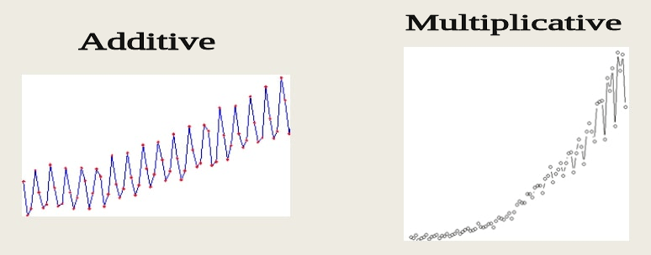
Additive vs Multiplicative Plot

Slide 21
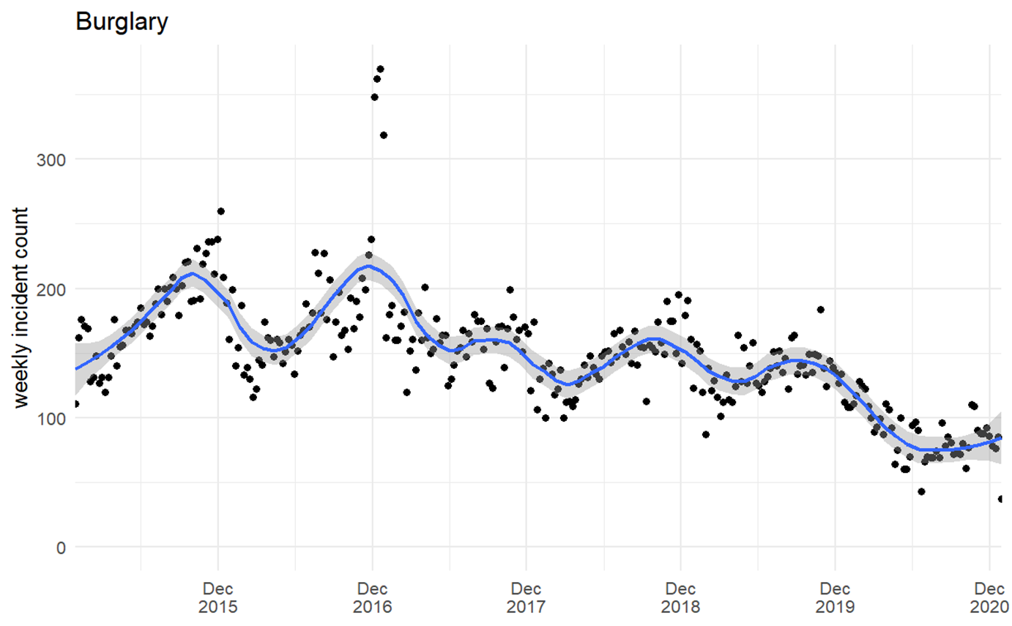
What about with our example?

Slide 22
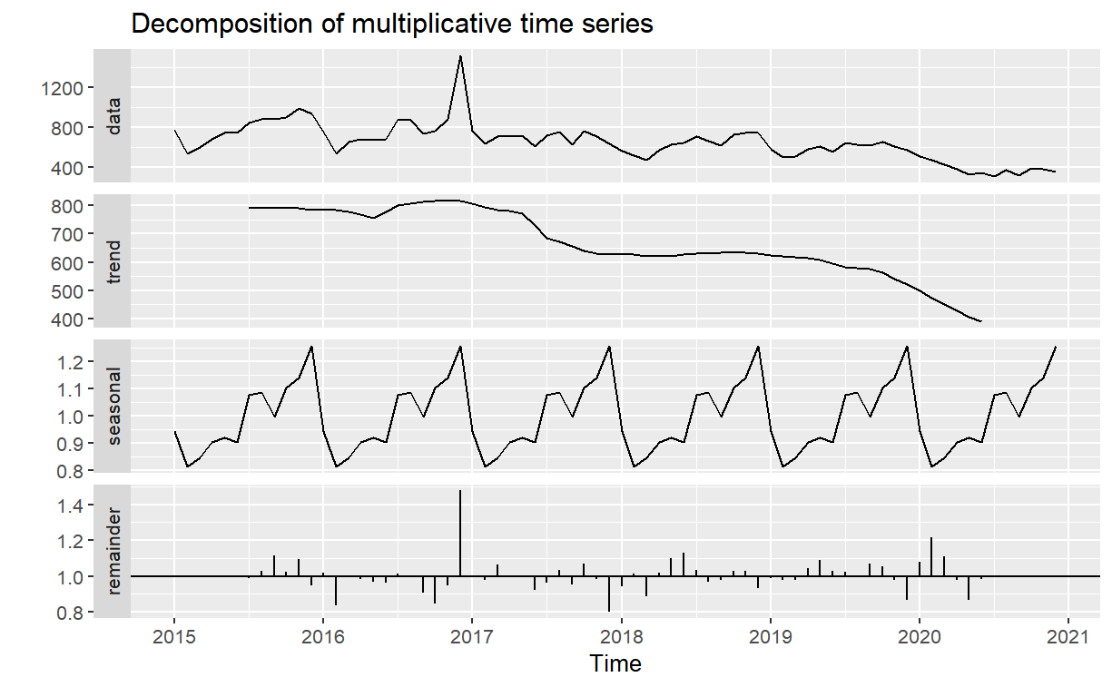
Decomposition of a multiplicative time series

Slide 23
Check for Stationarity
Stationarity = if its statistical properties such as mean, variance & covariance remain constant over time
We can examine this both;
Visually (the decomposition plot)
Statistically (the kppss, dickey-fuller test)
Make series stationary via differencing.
Notes:
We have to make sure out data is stationary before we can run different ARIMA models

Slide 24
The Three Main TS Models
Moving Averages: useful for identifying trend and trend cycles
Single Exponential Smoothing: used for time series with data with no trend or seasonality
ARIMA/SARIMA Models: suitable for multivariate non-stationary data

Slide 25
More on S/ARIMA models
Seasonal / Autoregressive Integrated Moving Average
Used to predict future trends for time series
“It is a form of regression analysis that evaluates the strength of the dependent variable relative to other changing variables”

Slide 26
More on ARIMA/SARIMA models
Seasonal (S) / Autoregressive (AR) Integrated (I) Moving average (MA)
ARIMA is characterised by three trend element; (p,d,q)
AR [p] = trend order (number of lagged observation)
I [d] = trend differencing (to make the series stationary)
MA [q] = trend order of moving average model
ARIMA(p,d,q)
SARIMA is characterised by an additional four elements; (P,D,Q,m)
P = seasonal autoregressive order
D = seasonal differencing
Q = seasonal moving average
m = the number of time steps for a single period
SARIMA(p,d,q)(P,D,Q)m

Slide 27
How do you choose the values for p,d,q and P,D,Q?
The autocorrelation function (ACF)
The partial autocorrelation function (PACF)

Slide 28
Steps to our second aim; B) “Explore how the trend in 2020 would have looked in the absence of the pandemic”
1. Count the weekly crime
2. Model the weekly calls (e.g, using the function ‘ARIMA’ from the “fable” package in R)
3. Generate the forecast (e.g, using the ‘forecast’ function from the ‘forecast’ package in R)
4. Plot the forecast

Slide 29
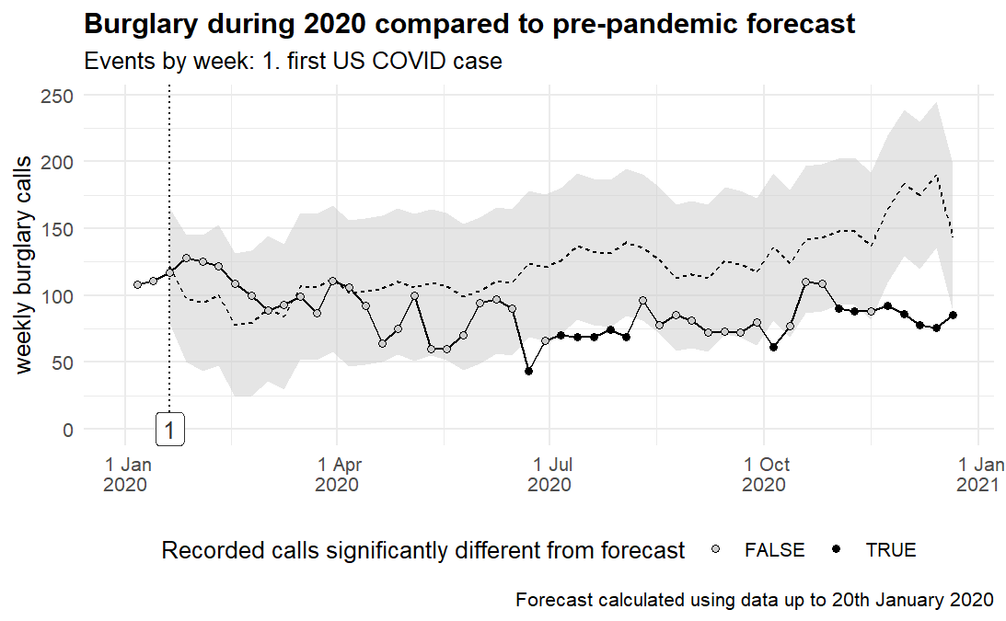
.
S/ARIMA(2,0,0)(1,0,0)[52]

Slide 30
Software
Python
Libraries: pandas. statsmodel, scikit-learn
R
Packages: fable, forecast, tseries
Functions: ARIMA, forecast, ts, auto.arima
FBProphet
https://facebook.github.io/prophet/

Slide 31
Any Questions?

Slide 32
Contact Details and Resources
Contact Details: Email: Nadia.kennar@manchester.ac.uk Twitter: @NadiaKennar Resources:
Matt Ashby: The initial evidence on the relationship between the coronavirus pandemic and crime in the U.S https://link.springer.com/content/pdf/10.1186/s40163-020-00117-6.pdf
Git-Hub for the code Code: https://github.com/mpjashby/covid19-crime
Data found in the R package ‘crimedata’ Citation; Ashby, M P J. (2018, August 12). Studying crime and place with the Crime Open Database. doi: http://doi.org/10.31235/osf.io/9y7qz
Copyright © year Institution. Created by Organisation, UK Data Service.

